Slide 1
Module 6
Web Usage Mining
- An introduction

Slide 2

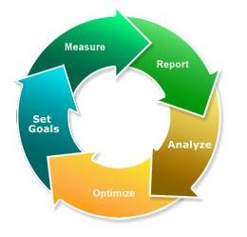
WEB LOG & CLICKSTREAM ANALYSIS
Dr. A. Bhuvaneswari

Slide 3
Introduction
Web usage mining: automatic discovery of patterns in clickstreams and associated data collected or generated as a result of user interactions with one or more Web sites.
Goal: analyze the behavioral patterns and profiles of users interacting with a Web site.

Slide 4
Introduction
Data in Web Usage Mining:
  Web server logs
  Site contents
  Data about the visitors, gathered from external channels
  Further application data
Not all these data are always available.
When they are, they must be integrated.
A large part of Web usage mining is about processing usage/ clickstream data.
  After that various data mining algorithm can be applied.
Bing Liu

Slide 5
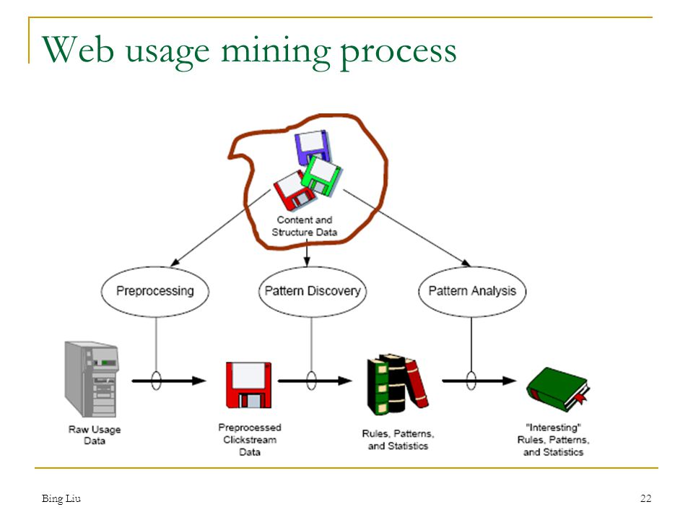

Bing Liu

Slide 6
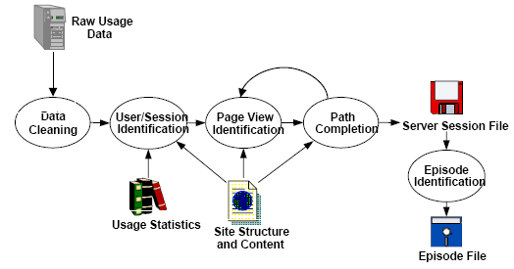
Pre-processing of web usage data
Bing Liu

Slide 7
Data cleaning
Data cleaning
  remove irrelevant references and fields in server logs
  remove references due to spider navigation
  remove erroneous references
  add missing references due to caching (done after sessionization)
Bing Liu

Slide 8
Definitions
Web Analytics as defined by Web Analytics Association :
“ Web Analytics is the measurement, collection, analysis and reporting of Internet data for the purposes of understanding and optimizing Web usage.”
Clickstream as defined by Internet Advertising Bureau (IAB) :
“The electronic path a user takes while navigating from site to site, and from page to page within a site. It is a comprehensive body of data describing the sequence of
activity between a user’s browser and any other Internet
resource, such as a Web site or third party ad server”
4/23/2012
Teradata Confidential

Slide 9
What is a web log?
A record of a visit to a web page
Visitor (IP address)
URL
Time of visit
Time spent on a page
Browser used
Referring URL
Type of request
Reply code
Number of bytes in the reply
etc…
4/23/2012
Teradata Confidential

Slide 10
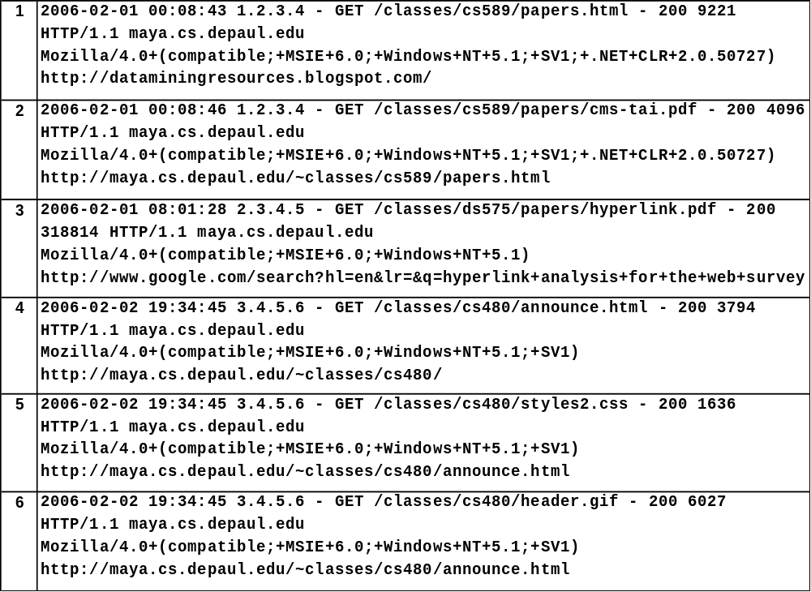
Web server logs
Bing Liu

Slide 11
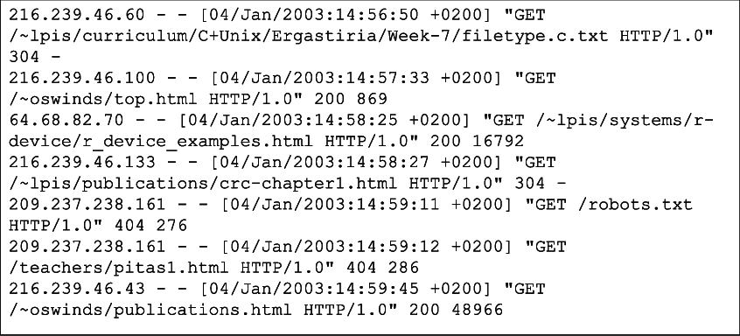
Web log analysis
Web log analysis is a simple kind of Web analytics processes that parses a log file from a web server, and based on the values contained in the log file, derives indicators about who, when, and how a web server is visited.
Usually reports are generated from the log files immediately, but the log files can alternatively be parsed to a database and reports generated on demand.

Slide 12
What is a clickstream?
A record of a path through web pages
Visitor (IP address)
URL
Time of visit
Time spent on a page
Browser used
Referring URL
Type of request
Reply code
Number of bytes in the reply
Next URL
etc…
A clickstream is the recording of the parts of the screen a computer user clicks
on, while web browsing or using another software application.
As the user clicks anywhere in the webpage or application, the action is logged on a client or inside the web server, as well as possibly the web browser, router, proxy server or ad server. Clickstream analysis is useful for web activity analysis, software testing, market research, and for analyzing employee productivity.
A small observation on the evolution of clickstream tracking: Initial clickstream or click path data had to be gleaned from server log files.
4/23/2012
Teradata Confidential

Slide 13
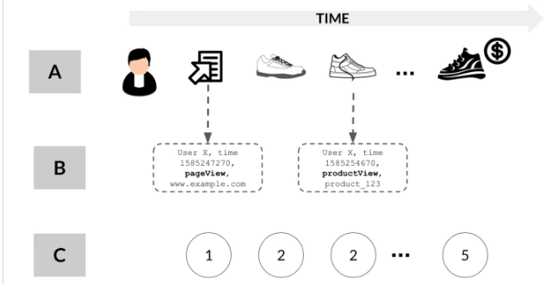
Online Purchase - Clickstream
Bing Liu

Slide 14
clickstream prediction challenge
Alice sample session and high-level view of the clickstream prediction challenge. We can distinguish three layers of representation: (A) is the actual session, and we are asked to predict that the session ends with a purchase based on the browsing pattern; (B) is the rich meta-data layer, which comprises, for each interaction between Alice and the website, information about time, website location, product properties; (C) is a symbolized, minimal information layer, in which all meta-data about the products is stripped and only event types are retained (see section "Data") for details on the final dataset). We target only (C) in our experiments, therefore providing a strong benchmark for similar analyses focusing at level (B).
Bing Liu

Slide 15
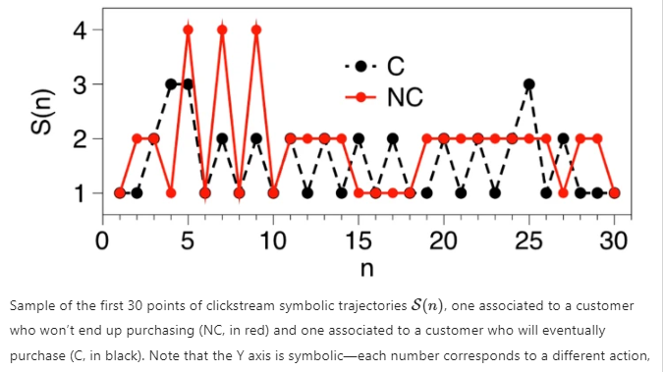
Bing Liu

Slide 16
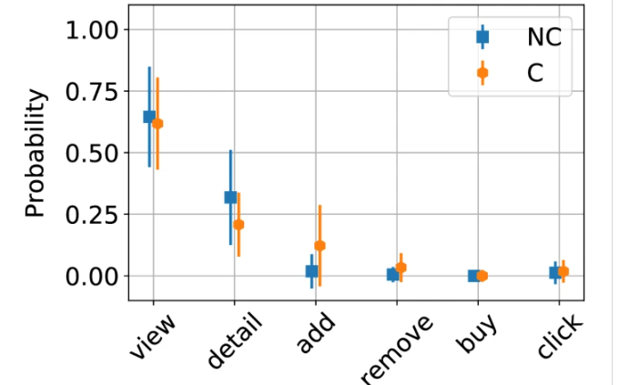
Shopping – Click streams
Bing Liu

Slide 17
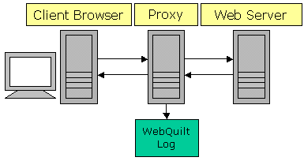
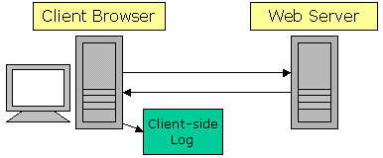
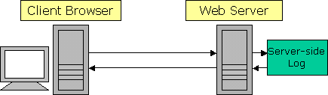
Web Log: where do they come from?
Servers
Done on most web servers
Standard formats
Proxy Log
Clients
Browsers, loggers on client machine
Must send data back
Proxies
Similar to servers
Hang out in between client and server
4/23/2012
Teradata Confidential

Slide 18
Why are web logs relevant?
Lots of data available
  Quantitative analysis is much more fun!
User behavior, patterns
  Real users, tasks
  Or at least more realistic users and tasks
Leaving the usability lab
  Testing effect
Fast, easy, cheap
  Automatic or almost-automatic
4/23/2012
Teradata Confidential

Slide 19
Some questions on Web usages
How has information been accessed?
How frequently?
What’s popular? What’s not?
How do people enter the site? Exit?
Where do people spend time?
How long do they spend there?
How do people travel within the site?
Who are the people visiting?
4/23/2012
Teradata Confidential

Slide 20
Some others questions
Structural
  What information has been added,
deleted, modified, moved?
Usage + Structural
  What happens when the site changes?
  Does navigation change?
  Does popularity change?
  What about missing data?
4/23/2012
Teradata Confidential

Slide 21
How do you analyze web logs?
Data Mining: task or intent unknown
  “Automated extraction of hidden predictive
information from (large) databases”
  Server log analysis
What are people doing?
Remote Usability Testing: task or intent known
  Similar to traditional lab usability testing
  Clickstream analysis
How well does the site support what people are doing?
4/23/2012
Teradata Confidential

Slide 22
Some Classic Measures
Clicks: The interaction between the user and the web server is measured by the click of a mouse
Visits: The number of times a user visits a specific web site. Every new session is counted as a new visit
Hits: Total number of server requests serviced by the server
Exits: Site exits, counted by site inactivity for more than 30 minutes
Unique Visitors: A Unique User who accesses the site in a specified period of time.
Repeated Visitor: The average number of times a user returns to a site over a specific time period
Page views: The view of any page by the user. A page may contain text, images, and other online elements and may be statically or dynamically generated and could contain single or multiple frames or screens
Sessions: IAB defines it to be an “A sequence of Internet activity made by one user at one site. If a user makes no request from a site during a 30 minute period of time, the next content or ad request would then constitute the beginning of a new visit “
Unique authenticated visitors: A unique visitor who logs on to a site
via a registration method using his/her user id and password
4/23/2012
Teradata Confidential

Slide 23
Some Classic Metrics
Page views per visit: Average number of page views per
visit
Page views per session: Average number of page views per session
Page views per hour/day: Average number of page views per hour/day
Clicks per session: Average number or clicks per session
Clicks per hour: Average number of clicks per hour
Time between clicks: The average duration of time spent
between two clicks
Hits per hour: Average number of hits to the web server per hour
Busy hour of the day: The highest number of hits to the web server in a particular hour of a day
4/23/2012
Teradata Confidential

Slide 24
Information from Web Analytics
Web Analytics
Personilization
System Improvement
Site Modification
Business Intelligence
Usage characteristics
How many visitors visit the page daily?
Who are the regular visitors?
What percentage of the visitors to the page are registered users?
What are the top pages that are visited on the web page?
What is the average visit time on the website?
How often does the visitor return to the site?
What is the average page depth of a visitor?
What is the geographic distribution of users of the website?
4/23/2012
Teradata Confidential

Slide 25
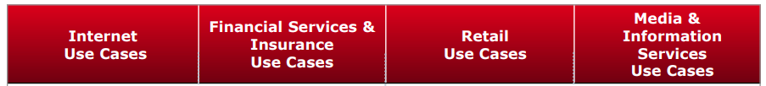









Advantage
 | Internet Use Cases | Financial Services & Insurance Use Cases | Retail Use Cases | Media & Information Services Use Cases
 | Social networking graph analysis Crowd-sourcing Virality analysis Content targeting Advanced click-stream analysis | Real-time fraud & link analysis Tick data analysis Trading surveillance Multi-variate pricing analysis for insurance Behavior pattern matching | Digital marketing attribution Online consumer behavior/patterns Advanced click-stream analysis Online targeting for personalization/ recommendations | Predictive and granular forecasting Advanced click-stream analysis Digital media consumer micro- targeting Ad optimization
“Analytics themselves don't constitute a strategy, but using them to optimize a distinctive business capability certainly constitutes a strategy.”
Teradata Conofidfential
22
4/23/2012

Slide 26
Web Log File Basic Analysis
Gives statistics such as
  number of hits
  average hits per time period
  what are the popular pages in your site
  who is visiting your site
  what keywords are users searching for to get to you
  what is being downloaded
Log data does not disclose the visitor’s identity
4/23/2012
Teradata Confidential

Slide 27
Identification of User
By IP address
  Not so reliable as IP can be dynamic
  Different users may use same IP
Through cookies
  Reliable but user may remove cookies
  Security and privacy issues
Through login
  Users have to register
4/23/2012
Teradata Confidential

Slide 28
Sessionising
Time oriented (robust)
  By total duration of session
    not more than 30 minutes
  By page stay times (good for short sessions)
    not more than 10 minutes per page
Navigation oriented (good for short sessions and when timestamps unreliable)
  Referrer is previous page in session, or
  Referrer is undefined but request within 10 secs, or
  Link from previous to current page in web
site
4/23/2012
Teradata Confidential

Slide 29
Identify sessions (sessionization)
In Web usage analysis, these data are the sessions of the site visitors: the activities performed by a user from the moment she enters the site until the moment she leaves it.
Difficult to obtain reliable usage data due to proxy servers and anonymizers, dynamic IP addresses, missing references due to caching, and the inability of servers to distinguish among different visits.
Bing Liu

Slide 30
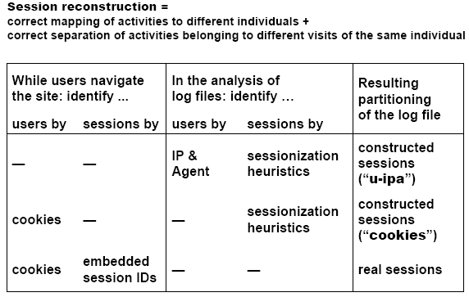
Sessionization strategies
Bing Liu

Slide 31
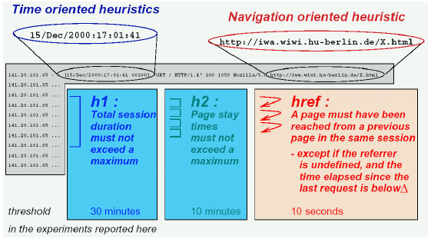
Sessionization heuristics
Bing Liu

Slide 32
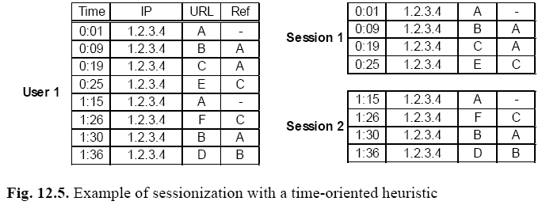
Sessionization example
Bing Liu

Slide 33
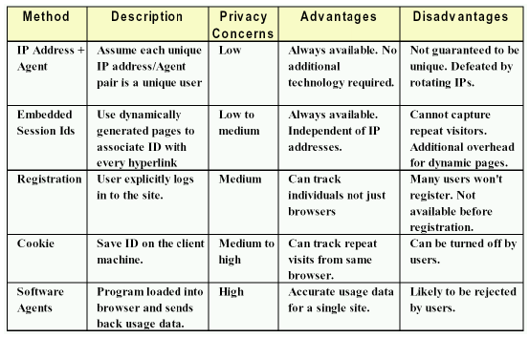
User identification
Bing Liu

Slide 34
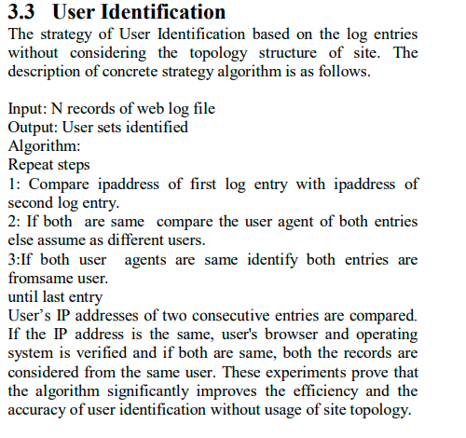
Bing Liu

Slide 35
What is user agent?
User Agent is unique to every person on the internet and holds technical information about your device and software.
Bing Liu

Slide 36
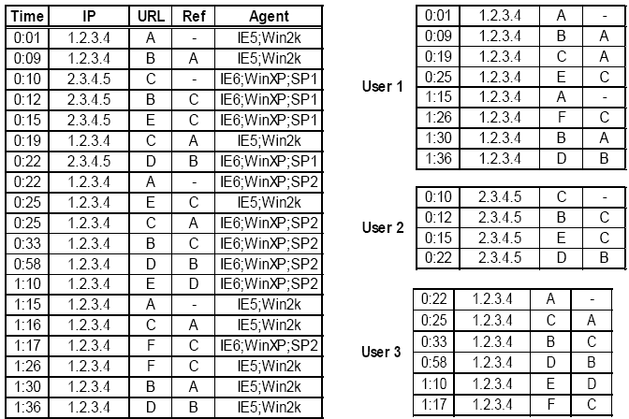
User identification: an example
Bing Liu

Slide 37
Pageview Identification
A pageview is an aggregate representation of a collection of Web objects contributing to the display on a user’s browser resulting from a single user action (such as a click-through).
Conceptually, each pageview can be viewed as a collection of Web objects or resources representing a specific “user event,” e.g., reading an article, viewing a product page, or adding a product to the shopping cart.
Bing Liu

Slide 38
Path completion
Client- or proxy-side caching can often result in missing access references to those pages or objects that have been cached.
For instance,
  if a user returns to a page A during the same session, the second access to A will likely result in viewing the previously downloaded version of A that was cached on the client-side, and therefore, no request is made to the server.
  This results in the second reference to A not being recorded on the server logs.
Bing Liu

Slide 39
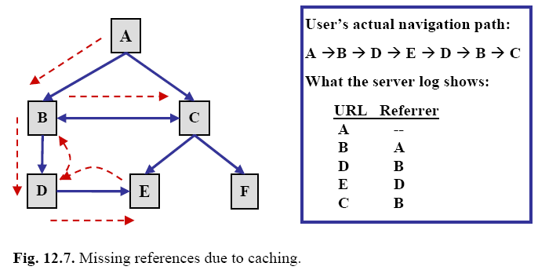
Missing references due to caching
Bing Liu

Slide 40
Path completion
The problem of inferring missing user references due to caching.
Effective path completion requires extensive knowledge of the link structure within the site
Referrer information in server logs can also be used in disambiguating the inferred paths.
Problem gets much more complicated in frame-based sites.
Bing Liu

Slide 41
Mining Navigation Patterns
Each session induces a user trail through the
site
A trail is a sequence of web pages followed by a user during a session, ordered by time of access
A pattern in this context is a frequent trail
Co-occurrence of web pages is important, e.g.
shopping-basket and checkout
Use a Markov chain model
4/23/2012
Teradata Confidential

Slide 42
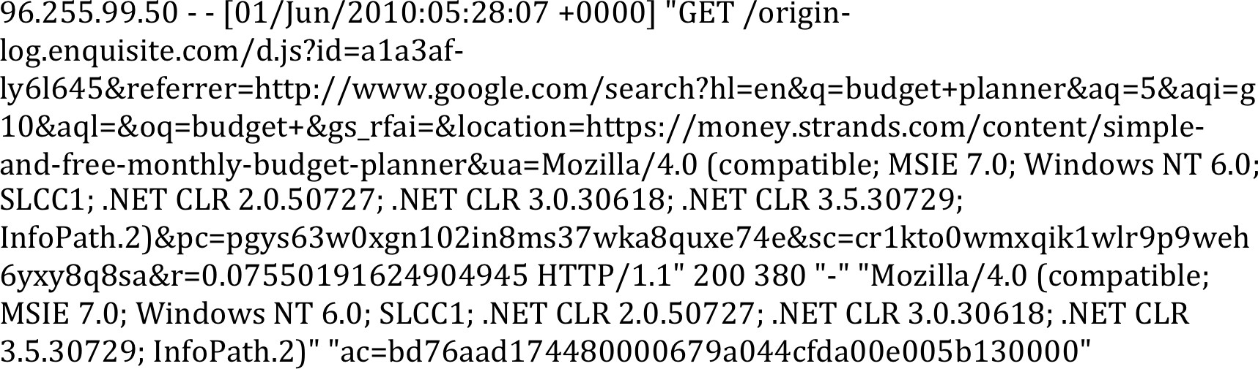
Starting with Raw Click Stream Data
4/23/2012
Teradata Confidential

Slide 43
Finding Referring Channels
4/23/2012
Teradata Confidential

Slide 44

Identifies the Customer
Identifies the customer by correlating Cookies captured during customer interactions …
referrer=http://www.facebook.com/
sc=ar78to0wdxq143lr9p9weh6yxy8318sa pc=pgys63w0xgn102in8ms37wka8quxe74e ac=bd76aad17448wgng0679a044cfda00e005b130000
Persistent and Network Cookies remain unchanged
4/23/2012
Teradata Confidential

Slide 45


Creates a Session Definition
Tracking of Customer Interaction Behavior During the Session
4/23/2012
Teradata Confidential

Slide 46
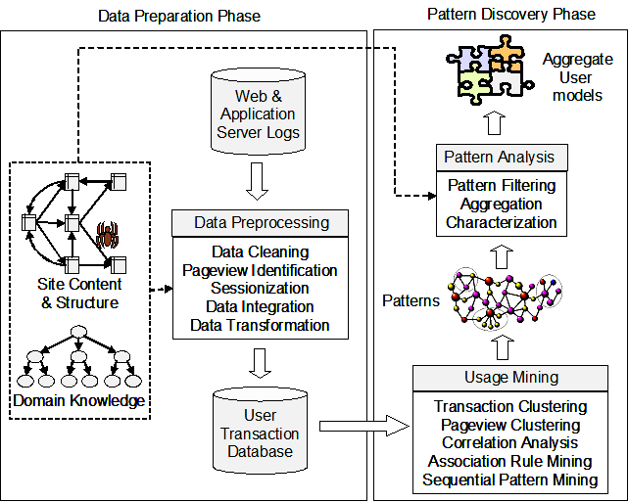
Web usage mining process
Bing Liu

Slide 47
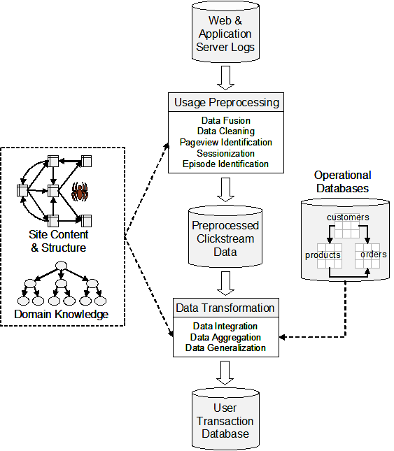
Data preparation
Bing Liu

Slide 48
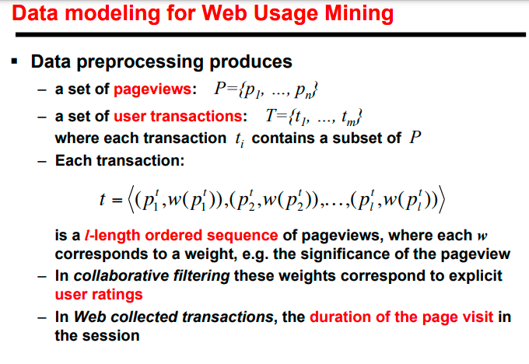
Bing Liu

Slide 49
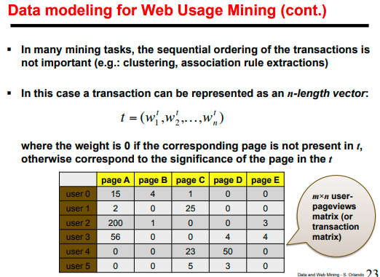
Bing Liu

Slide 50
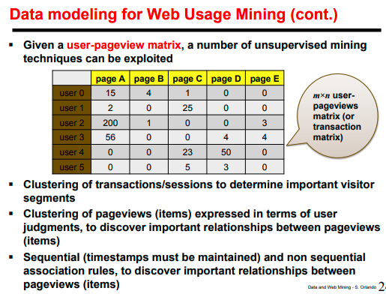
Bing Liu

Slide 51
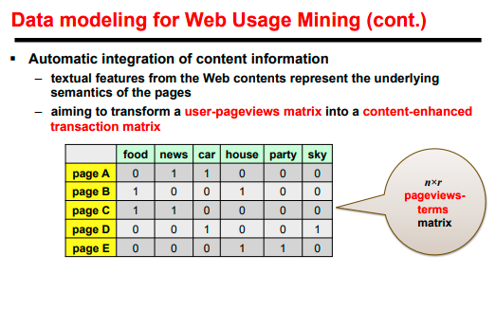
Bing Liu

Slide 52
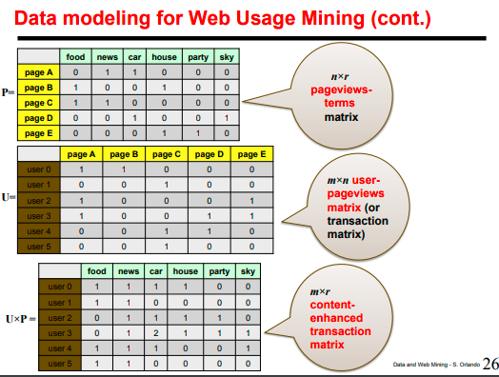
Bing Liu

Slide 53
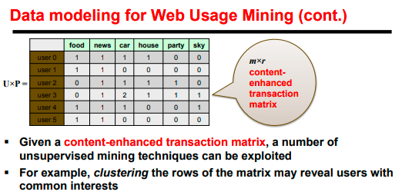
Bing Liu

Slide 54
Integrating with e-commerce events
Either product oriented or visit oriented
Used to track and analyze conversion of browsers to buyers.
  Major difficulty for E-commerce events is defining and implementing the events for a site, however, in contrast to clickstream data, getting reliable preprocessed data is not a problem.
Another major challenge is the successful integration with clickstream data
Bing Liu

Slide 55
Product-Oriented Events
Product View
  Occurs every time a product is displayed on a page view
  Typical Types: Image, Link, Text
Product Click-through
  Occurs every time a user “clicks” on a product to get more information
Bing Liu

Slide 56
Product-Oriented Events
Shopping Cart Changes
  Shopping Cart Add or Remove
  Shopping Cart Change - quantity or other feature (e.g. size) is changed
Product Buy or Bid
  Separate buy event occurs for each product in the shopping cart
  Auction sites can track bid events in addition to the product purchases
Bing Liu

Slide 57
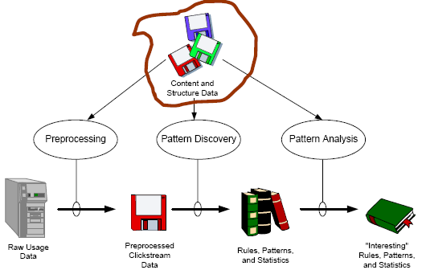
Web usage mining process
Bing Liu

Slide 58
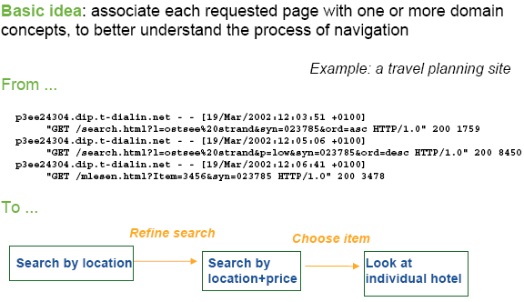
Integration with page content
Bing Liu

Slide 59
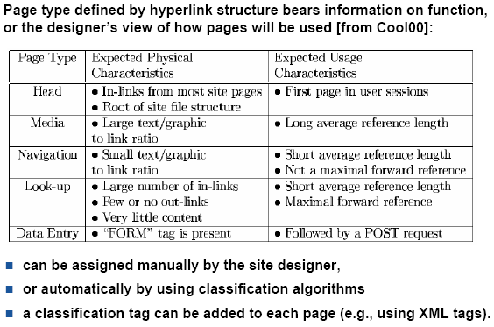
Integration with link structure
Bing Liu

Slide 60
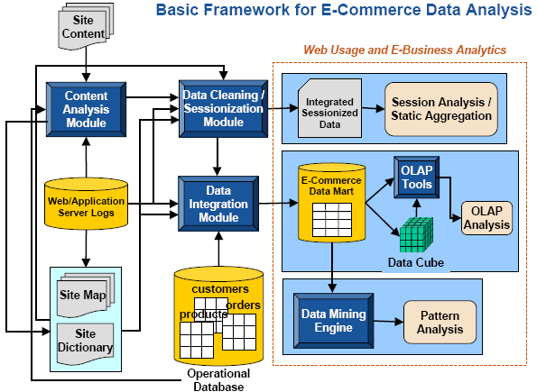
E-commerce data analysis
Bing Liu

Slide 61
Session analysis
Simplest form of analysis: examine individual or groups of server sessions and e-commerce data.
Advantages:
  Gain insight into typical customer behaviors.
  Trace specific problems with the site.
Drawbacks:
  LOTS of data.
  Difficult to generalize.
Bing Liu

Slide 62
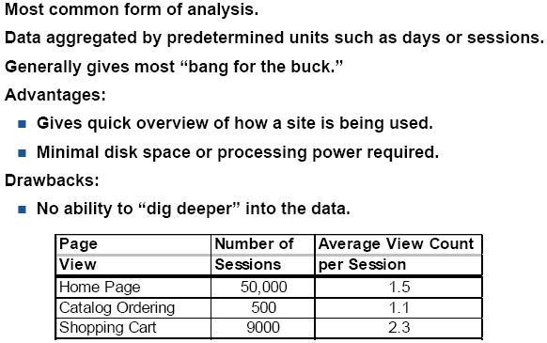
Session analysis: aggregate reports
Bing Liu

Slide 63
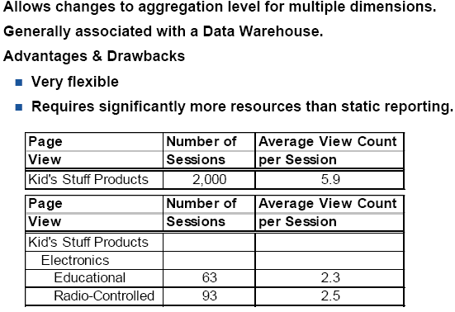
OLAP
Bing Liu

Slide 64
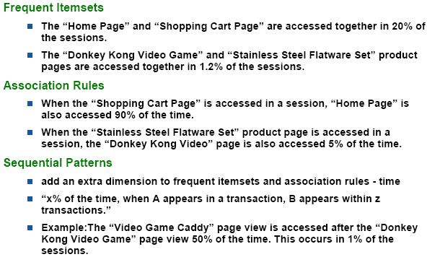
Data mining
Bing Liu

Slide 65
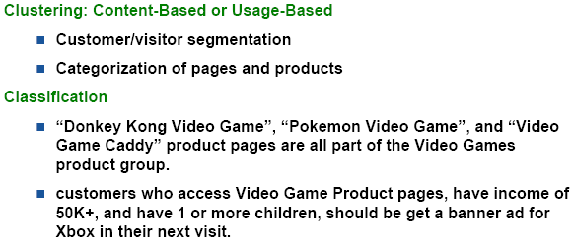
Data mining (cont.)
Bing Liu

Slide 66
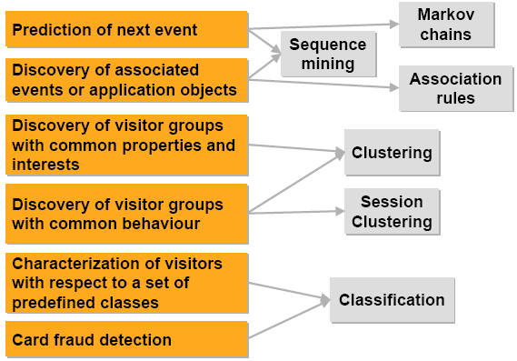
Some usage mining applications
Bing Liu

Slide 67
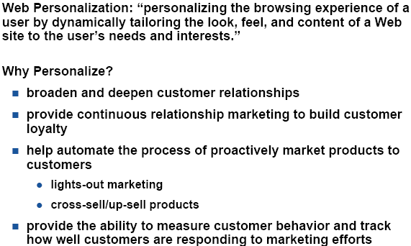
Personalization application
Bing Liu

Slide 68
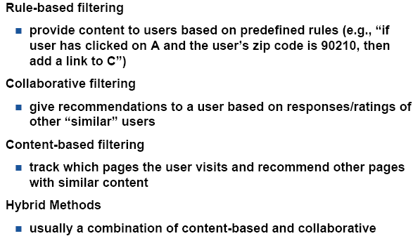
Standard approaches
Bing Liu

Slide 69
Summary
Web usage mining has emerged as the essential tool for realizing more personalized, user-friendly and business-optimal Web services.
The key is to use the user-clickstream data for many mining purposes.
Traditionally, Web usage mining is used by e-commerce sites to organize their sites and to increase profits.
It is now also used by search engines to improve search quality and to evaluate search results, etc, and by many other applications.
Bing Liu

